Slide 1
Theory of Computation
CSE-3101
Md. Manowarul Islam
Lecturer, Dept of CSE
JnU

Slide 2
Finite Automata
Finite Automata or a Finite State Machine is the simplest computational model with extremely limited amount of memory.
  Deterministic Automata (DFA)
  Nondeterministic Automata (NFA)
Md. Manowarul Islam, Dept. of CSE, JnU

Slide 3


Finite Automata
DFA
NFA
Md. Manowarul Islam, Dept. of CSE, JnU

Slide 4
Deterministic Finite Automata
Formal Definition
A deterministic finite automaton is a 5-tuple M = (Q, Σ, δ, q, F), where
Q is a finite set, whose elements are called states
Σ is a finite set, called the alphabet; the elements of Σ are called symbols
δ : Q × Σ → Q is a function, called the transition function
q is an element of Q; it is called the start state
F is a subset of Q; the elements of F are called accept states
Md. Manowarul Islam, Dept. of CSE, JnU

Slide 5
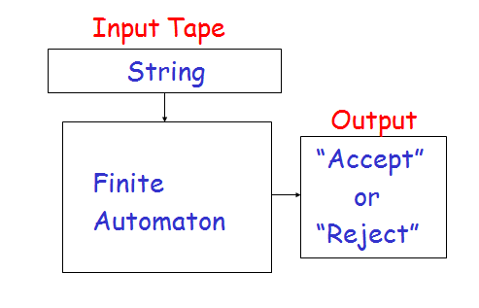
Deterministic Finite Automata
Md. Manowarul Islam, Dept. of CSE, JnU

Slide 6
What does a DFA do on reading an input string?
Input: a word w in ∑*
Question: Is w acceptable by the DFA?
Steps:
  Start at the “start state” q₀
  For every input symbol in the sequence w do
    Compute the next state from the current state, given the current input symbol in w and the transition function
  If after all symbols in w are consumed, the current state is one of the final states (F) then accept w;
  Otherwise, reject w.
Md. Manowarul Islam, Dept. of CSE, JnU

Slide 7
Example #1
Build a DFA for the following language:
  L = {w | w is a binary string that contains 01 as a substring}
Steps for building a DFA to recognize L:
  ∑ = {0,1}
  Decide on the states: Q
  Designate start state and final state(s)
  δ: Decide on the transitions:
Final states == same as “accepting states”
Other states == same as “non-accepting states”
Md. Manowarul Islam, Dept. of CSE, JnU

Slide 8
DFA for strings containing 01
Regular expression: (0+1)*01(0+1)*
What makes this DFA deterministic?
Q = {q₀,q₁,q₂}
∑ = {0,1}
start state = q₀
F = {q₂}
Transition table
1
0
0,1
start
0
1
q₀
q₁
q₂
Final
state
symbols
0
1
q₀
q₁
q₀
states
q₁
q₁
q₂
*q₂
q₂
q₂
Md. Manowarul Islam, Dept. of CSE, JnU

Slide 9
END
Md. Manowarul Islam, Dept. of CSE, JnU

